Slide 1
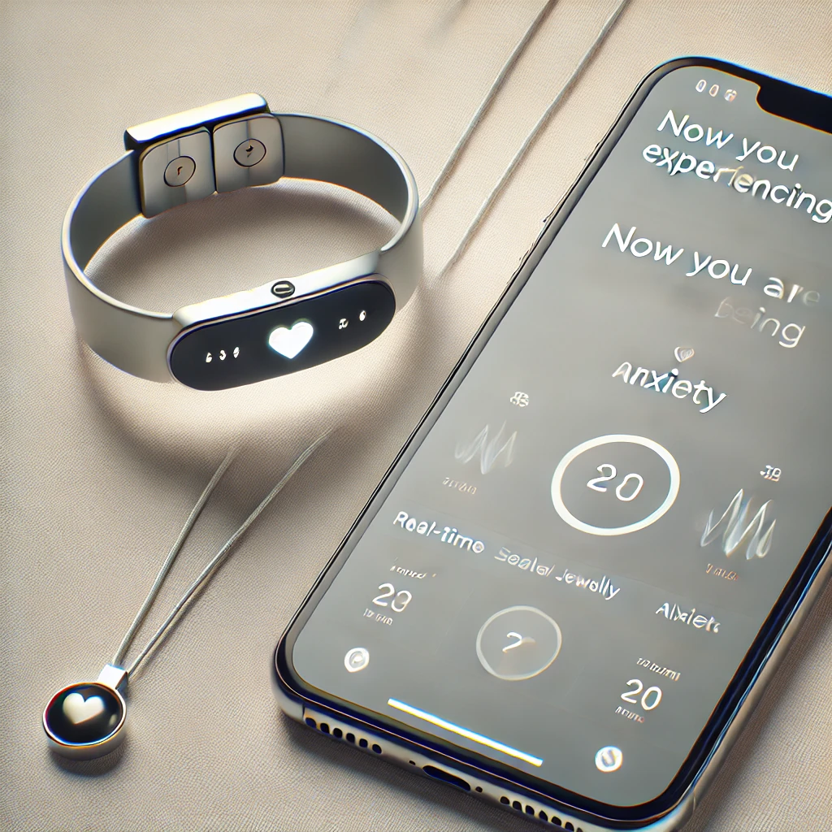

Jewelry That Cares: Smart Jewelry for Anxiety Detection
Michal Ginat & Gal Polak
Supervisor - Dr. Unkelos-Shpigel Naomi &
Dr. Levi Meira (Shenkar College)

Slide 2

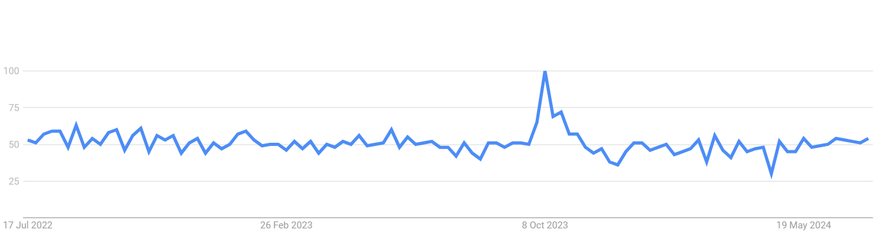
Introduction
320 million people affected globally (WHO, 2024)
32% of Israeli adults suffer from anxiety (Macabbi, 2023)
Tech and social media fuel anxiety, especially in youth
Rising anxiety levels demand effective interventions
‘Anxiety’ on google trends
2
Notes:
Anxiety disorders have reached unprecedented levels globally, with 320 million people affected (WHO, 2024).
In Israel, nearly 32% of the adult population suffers from anxiety disorders (Macabbi Healthcare, 2023).
Technological advancements and social media contribute to increased anxiety, especially among younger generations.
The rising levels of anxiety highlight the need for effective mental health interventions.
The onset of the war on October 7, 2024, further intensified this interest according to the findings from Google searches [7], highlighting the urgent need for mental health support and exacerbating the existing challenges therapists face in addressing the widespread demand for anxiety management.

Slide 3
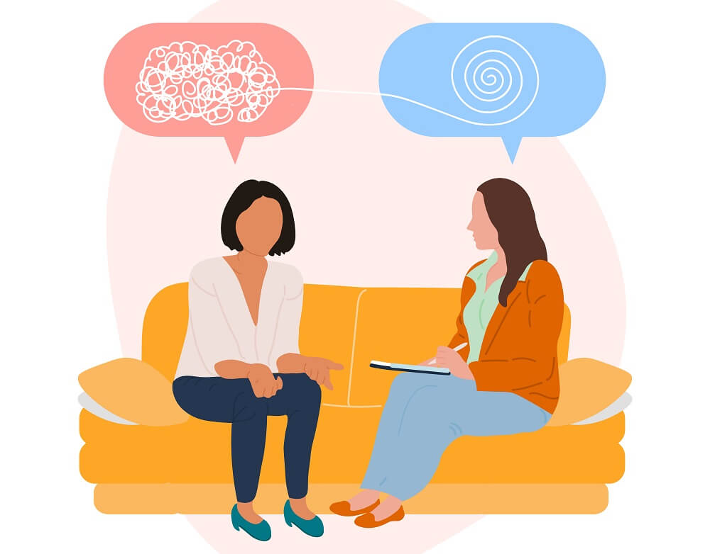

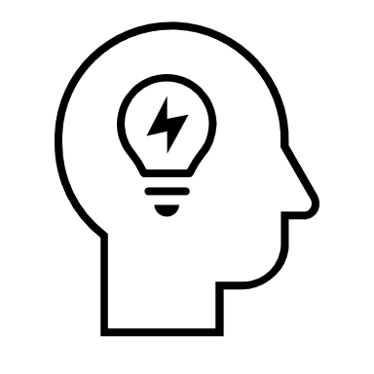

Motivation
High demand, but few professionals
Need for innovative support solutions between therapy sessions
Hard to book therapist appointments in peripheral areas.
3
Notes:
Growing demand for mental health support amidst a shortage of professionals.
Continuity of care is a significant challenge due to limited access to therapists.
Need for innovative solutions to support individuals between therapy sessions. Many patients struggle with managing their mental health on a daily basis when they are not in direct contact with their therapists or other mental health professionals.

Slide 4
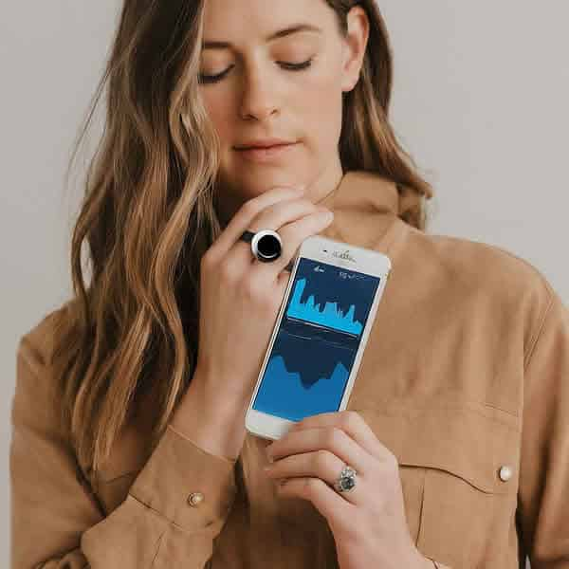

Smart Jewelry to Manage Anxiety Attacks
“However, as recent studies suggest, the effects of such tracking devices are debatable, seem to be short-lived, and consumers often stop using them after a short period of time.״
Jakicic, J. M. et al. Effect of Wearable Technology Combined With a Lifestyle Intervention on Long-term Weight Loss. JAMA 316, 1161–1171, doi:10.1001/jama.2016.12858 (2016).
Ledger, D. & McCaffrey, D. How the Science of Human Behavior Change Offers the Secret to Long-Term Engagement. Retrieved 4 March 2017 from https://endeavourpartners.net/assets/Endeavour-Partners-Wearables-White-Paper-20141.pdf (2014).
4
Notes:
Smart devices equipped with biometric sensors can detect physiological indicators of stress.
Provide real-time feedback and suggest stress-reducing activities like guided breathing exercises.
Help users regulate emotions and maintain comfort by offering personalized interventions.

Slide 5



Interviews - psychologists
Michal Meidan
Documentation by patients
Elad Tal
Emergency call
Rivka Amir
Personalized anxiety management techniques
5
Notes:
Unfortunately, we were unable to reach the patients
after many efforts
Michal Meidan: Emphasizes the crucial role of documentation by patients in tracking their anxiety, helping both the patient and therapist to understand triggers and patterns
Elad Tal: Warns that while connecting with a close person during an anxiety attack may seem helpful, it can sometimes make the anxiety worse if the close person is unavailable, so this strategy should be used with caution
Rivka Amir: Highlights the importance of personalized anxiety management techniques, such as grounding methods and the therapeutic value of meaningful wearable items

Slide 6
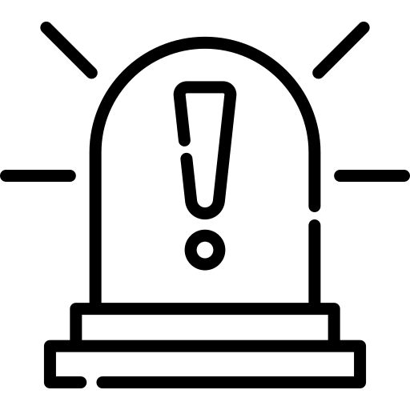
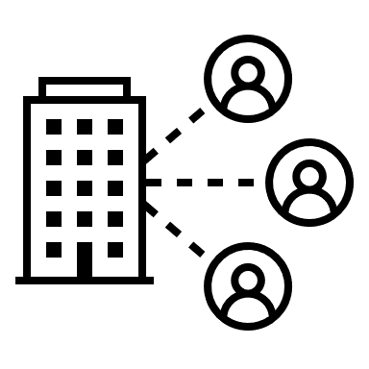
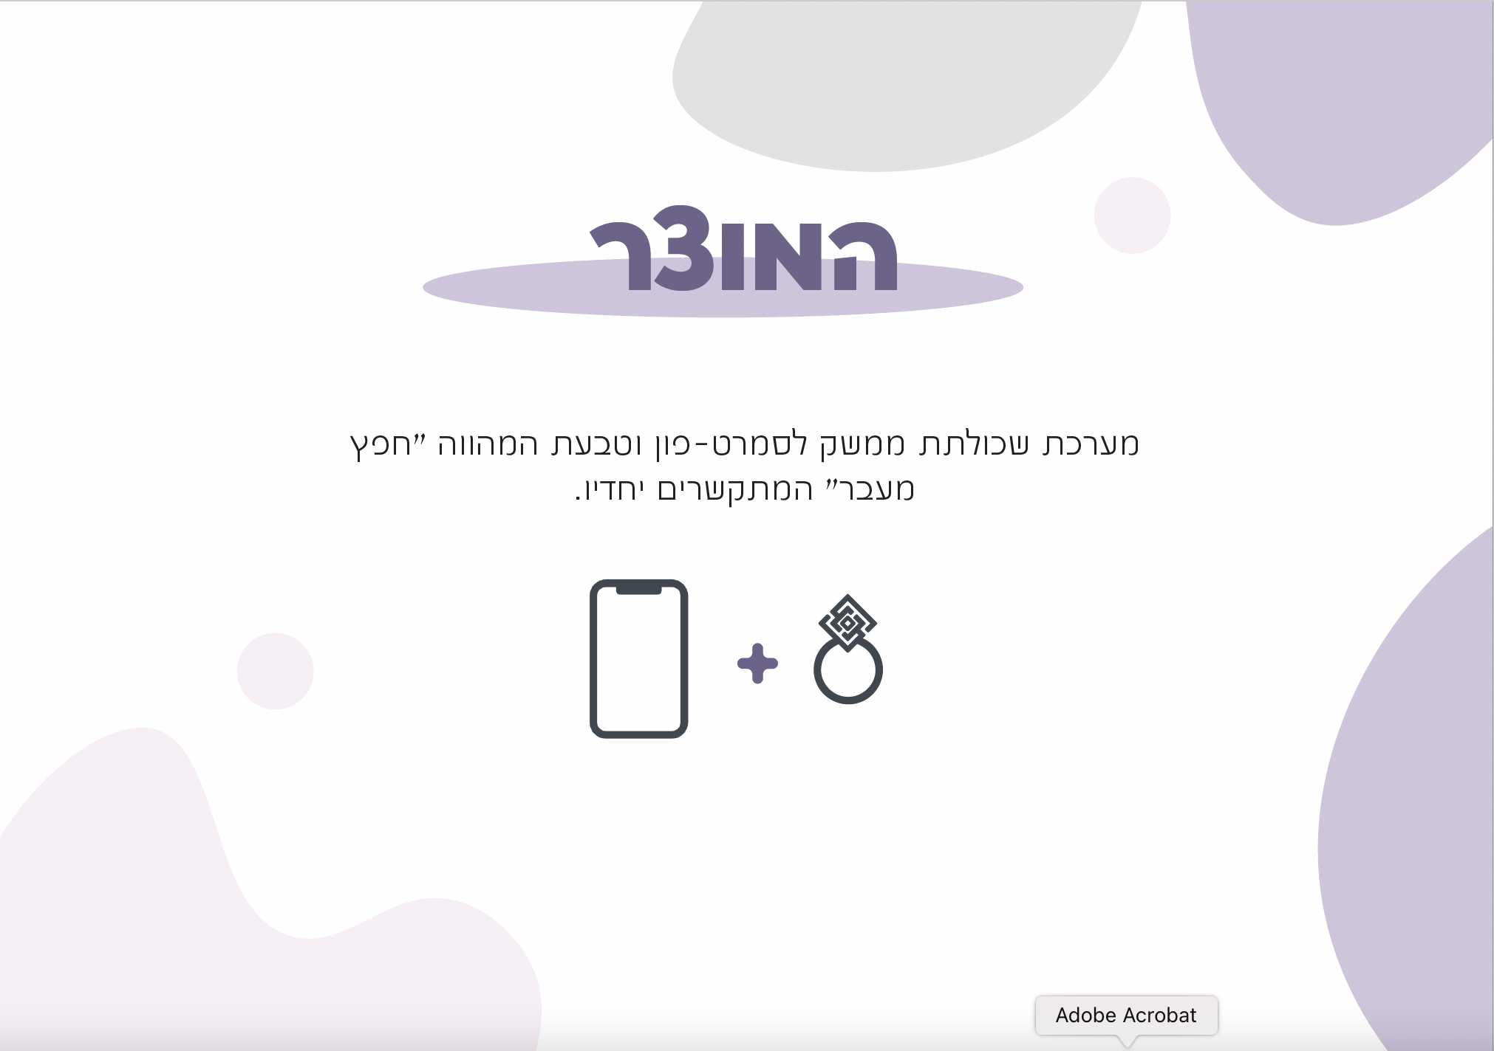



Our Solution - AnxiEase
Main Features
Real-Time Anxiety Alert
Therapist Interactions
Experience documentation
Calming Actions
Physiological sensors
HRV
EDA
6
Notes:
Access to the patient
Access to a therapist Fills gaps between therapy sessions.
Enhances real-time understanding for therapists.
Promotes well-being and reduces extreme distress.
Supports personalized mental health care.

Slide 7
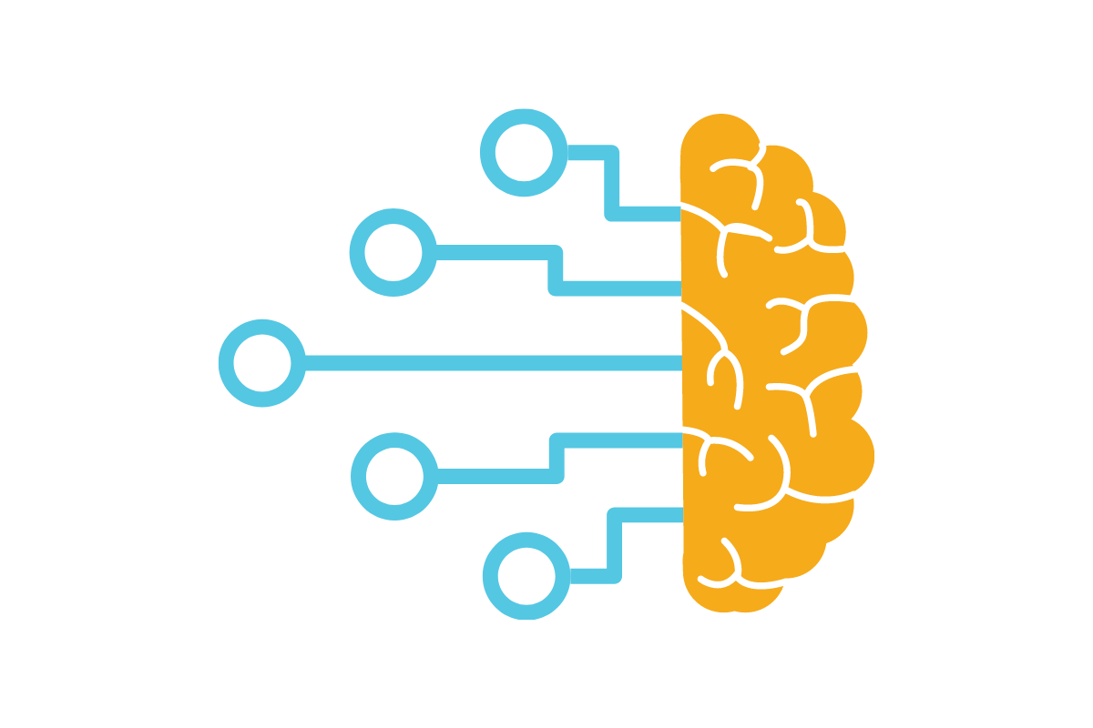
Enhancing Anxiety Detection with Machine Learning
No Standard Measures: Anxiety detection varies from person to person.
Limitations of Current Methods: Traditional techniques often miss accurate detection.
Machine Learning Advantage: Adapts to individual patterns for better detection.
Project Integration: We’ll use this to enhance real-time anxiety monitoring.
Notes:
Measuring anxiety involves capturing how individuals respond to anxiety through various physiological and physical signals. Given that anxiety manifests differently from person to person, influenced by factors such as body condition, age, gender, and experience, establishing universally accepted numerical values for anxiety indicators remains challenging.
To address these variables, computational techniques like artificial neural networks and fuzzy logic are employed to manage the uncertainties in defining stress [20]. As a result, machine learning is increasingly utilized to improve anxiety detection.

Slide 8

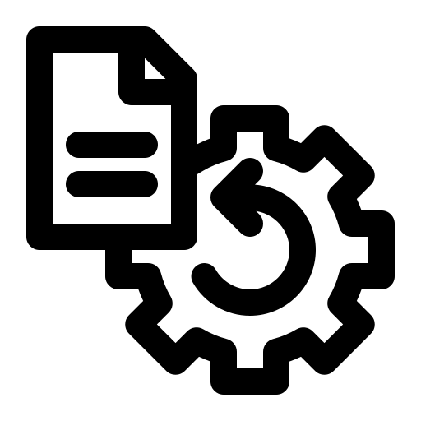

Challenges
Sensor Data Analysis: The main challenge is accurately interpreting physiological data to detect anxiety episodes
Real-Time Processing: Managing sensor data in real-time while maintaining performance
User Engagement: Encouraging consistent use, especially during stressful situations

Slide 9
Main Functional Requirements
1. User Registration and Login
2. Anxiety Detection and Alerts
3. Calming Actions
3.1 Interaction with a Relaxing Chatbot
3.2 Breathing Exercises
3.3 Grounding Exercises
3.4 Displaying Soothing Texts
3.5 Playing Calming Music
4. Documentation and Monitoring
5. Personal Area for Patients
6. Therapist interaction
7. Incentives for Anxiety Management

Slide 10
Main Non-Functional Requirements
1. Accuracy: Detect anxiety episodes with at least 80% accuracy.
2. Security: Ensure 99% data protection with no breaches or data loss.
3. Performance: Support real-time alerts and actions with 80% accuracy and under 30-second response time.
4. Availability: Maintain reliable system uptime.
5. Privacy: Adhere to data protection regulations (GDPR, HIPAA).
6. Usability: Ensure high-quality user experience per ISO 9241 standards.
10
Notes:
Compliance: Adhere to data protection regulations like GDPR and HIPAA, ensuring legal and ethical handling of patient data.
GDPR
The General Data Protection Regulation (GDPR) is a comprehensive data privacy law enacted by the European Union (EU). It sets guidelines for the collection, processing, and storage of personal data of individuals within the EU and EEA. GDPR aims to enhance individuals’ control over their personal data and simplify regulations for international businesses¹.
HIPAA
The Health Insurance Portability and Accountability Act (HIPAA) is a U.S. law designed to protect sensitive patient health information from being disclosed without the patient’s consent or knowledge. It establishes national standards for electronic health care transactions and addresses the security and privacy of health data

Slide 11
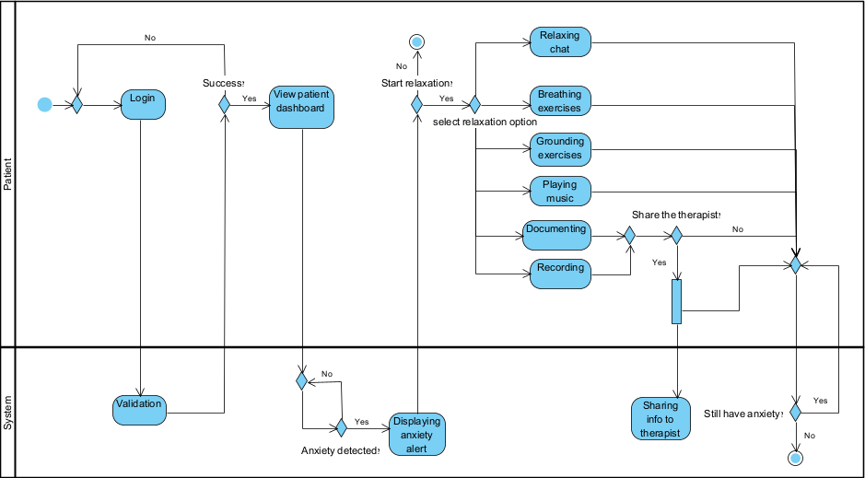
Activity Diagram 1 - Patient and the system
11

Slide 12
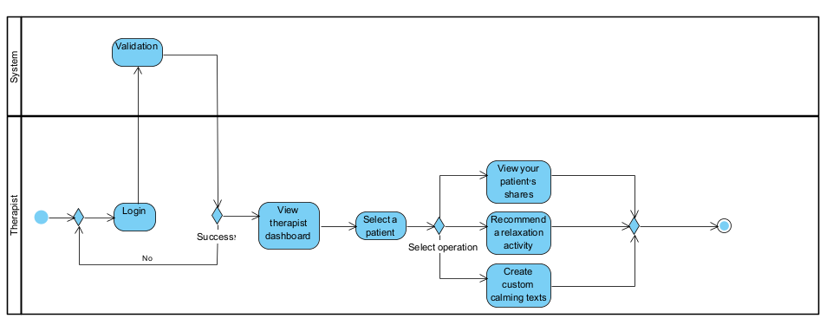

Activity Diagram 2 - Therapist and the system
12

Slide 13
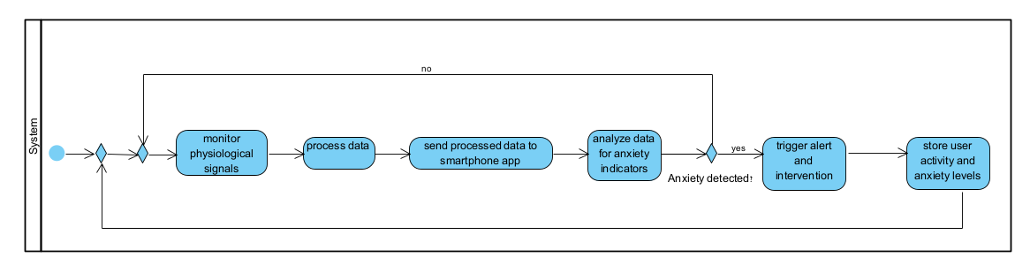
Activity Diagram 3 - The system
13

Slide 14
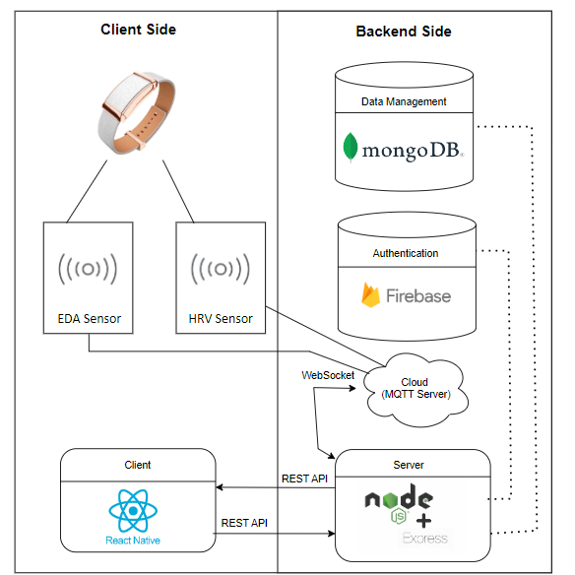
Architecture

Slide 15
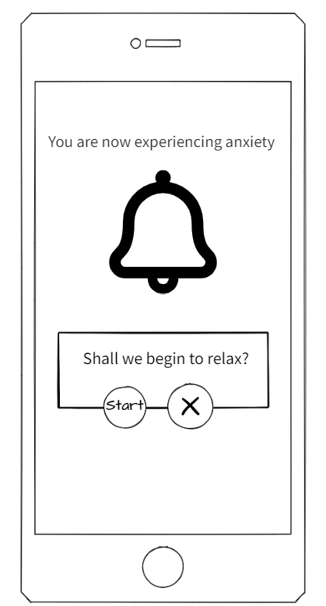
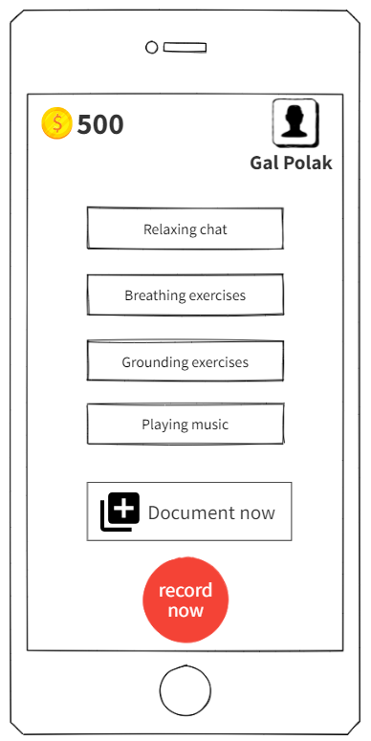
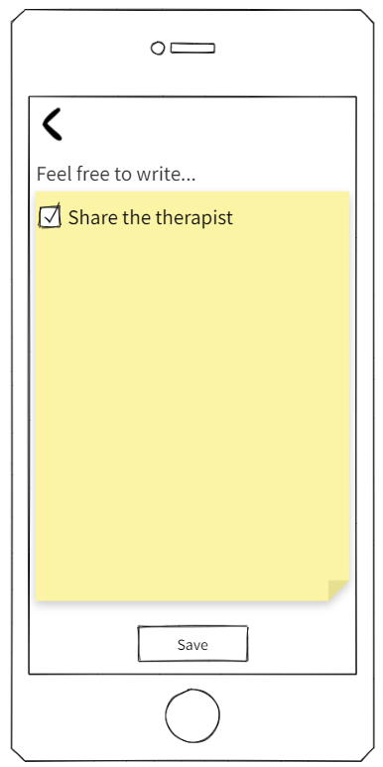
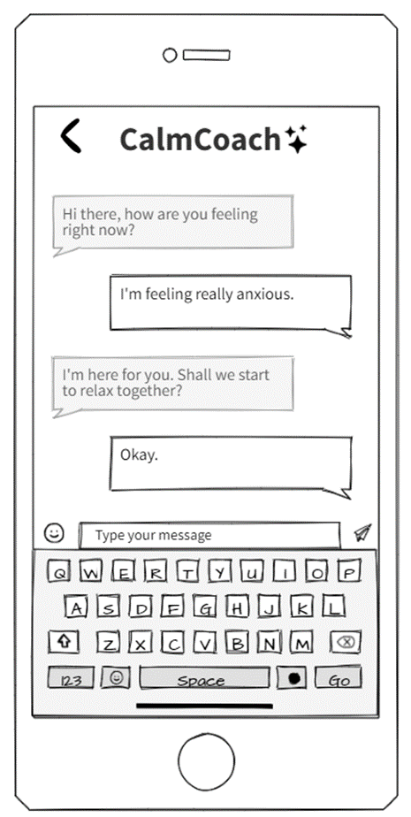
Mobile Application Interface

Slide 16
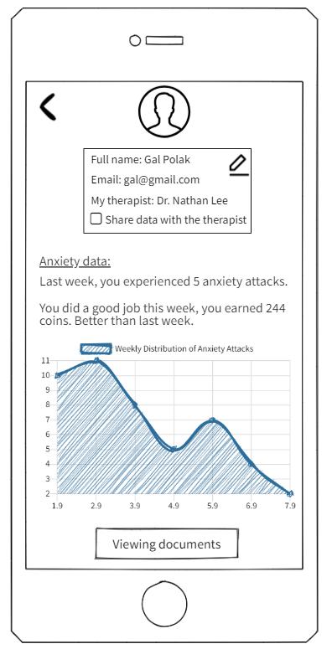
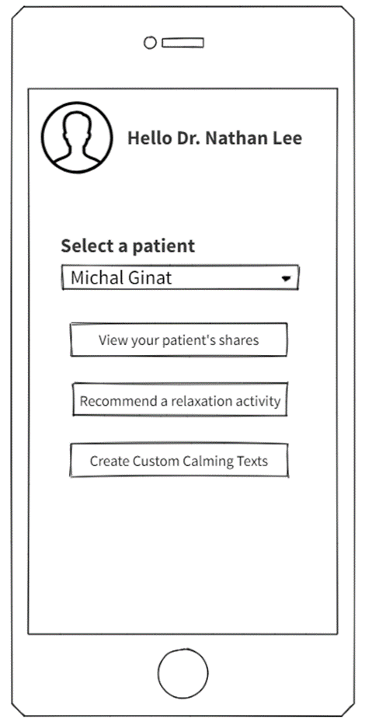
Mobile Application Interface

Slide 17
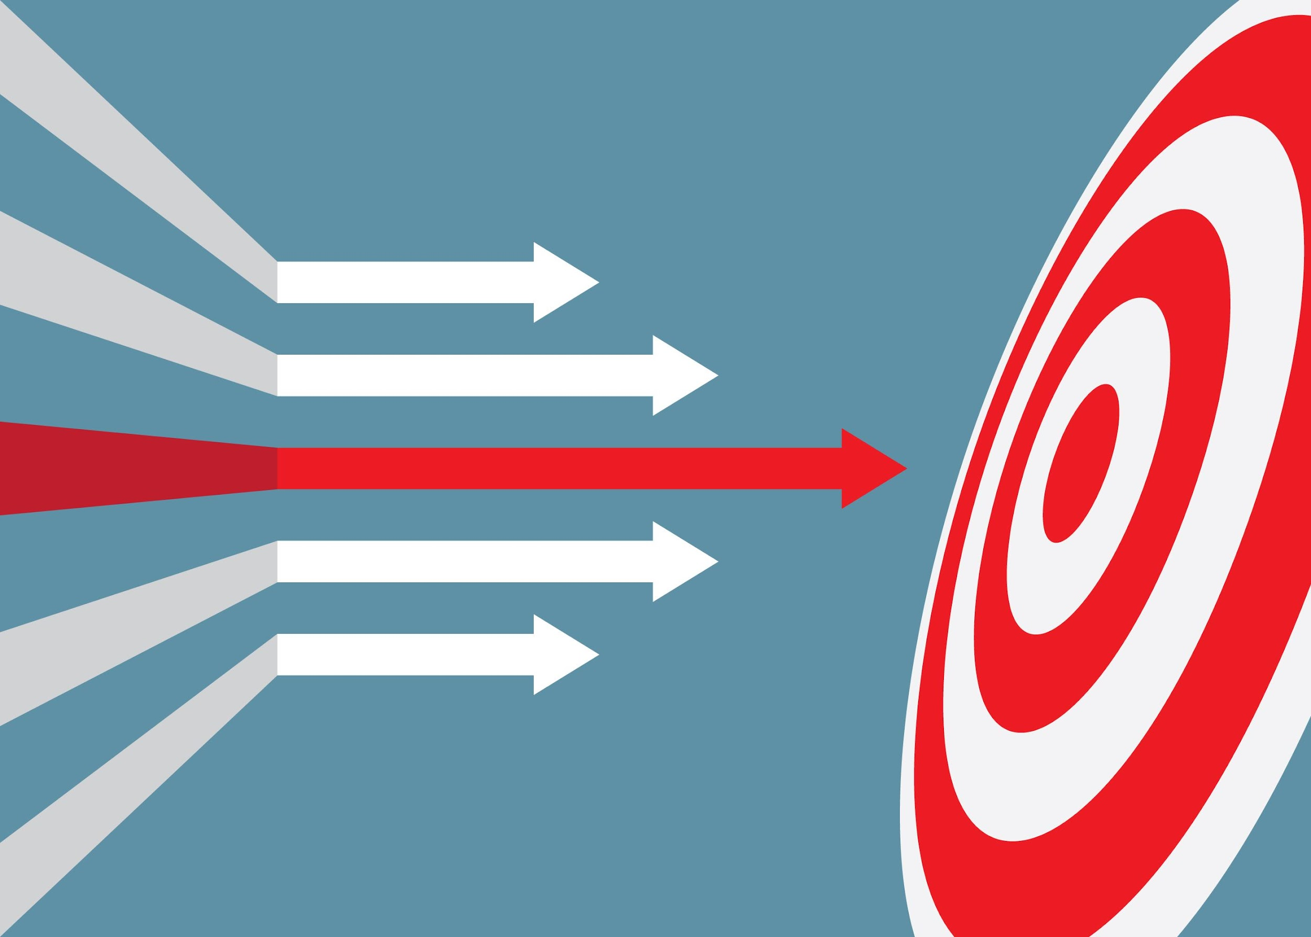

Expected Achievements and Success Metrics
Real-Time Detection: Detect anxiety episodes instantly using wearable sensors.
Detection Accuracy: 80% accuracy, response time under 30 seconds.
Personalized Interventions: Provide customized calming actions based on patient needs.
User Satisfaction: 70% adoption, 85% satisfaction.
Therapist Collaboration: Share detailed reports for tailored treatment plans. Therapeutic Outcomes: Reduced anxiety frequency and intensity.
Notes:
"Let’s go over the key achievements we expect from our project:
Real-Time Detection: Our system will instantly detect anxiety episodes using data from wearable sensors, ensuring timely intervention.
Personalized Interventions: We’ll provide customized calming actions tailored to each patient’s needs, enhancing the effectiveness of anxiety management.
Therapist Collaboration: The system will facilitate continuous collaboration between therapists and patients by sharing detailed reports, enabling tailored treatment plans.

Slide 18
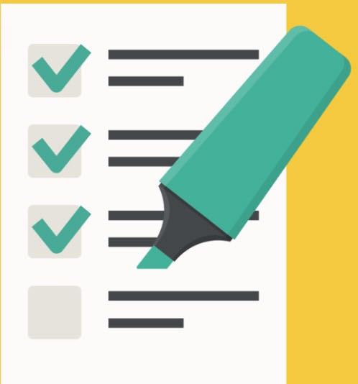
Testing Plan
Scope: Test mobile app, wearable device, sensor data accuracy, and user interactions.
Objectives: Ensure functionality, accurate anxiety detection, effective interventions, and data sync.
Approach: Automated & manual testing with real-world scenarios and sensor simulations.
Constraints: Simulated sensor data, internet dependency.
Notes:
We’ll test the app and wearable device for accuracy and reliability, focusing on anxiety detection, interventions, and real-time data sync through testing.

Slide 19




Thank you

